Slide 1
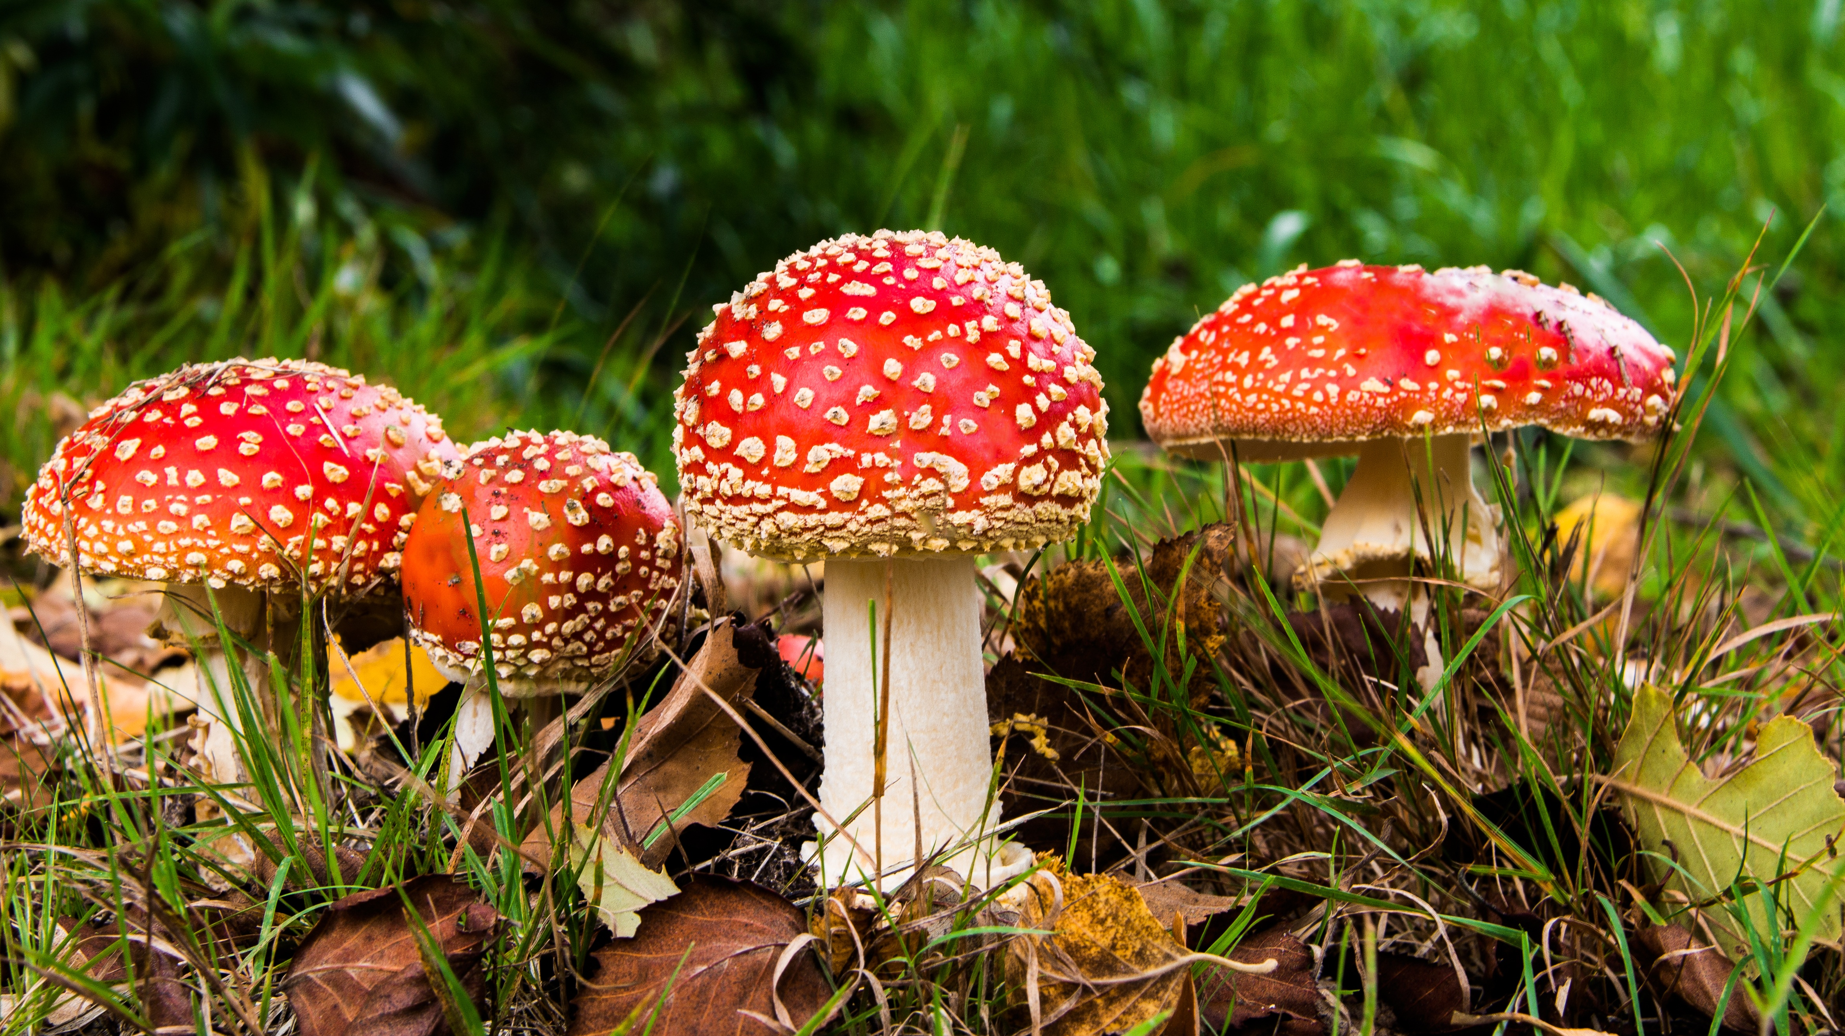
Deadly Mushroom Classification
Rachel Nelson
Notes:
Hello, my name is Rachel Nelson and today we will be walking through deadly mushroom classification

Slide 2
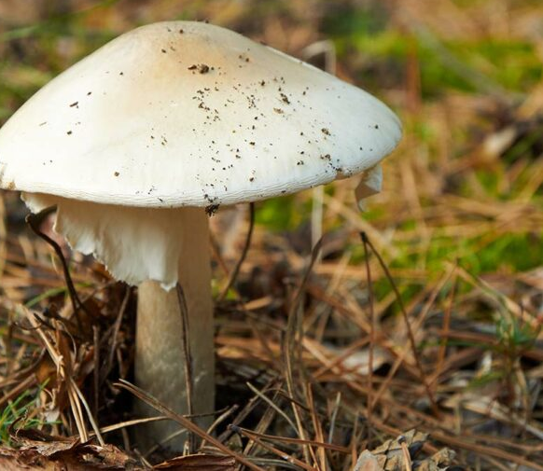
Problem
Is this mushroom safe to eat?
Notes:
Mushroom foraging, also known as mushroom hunting, mushrooming and mushroom picking, is an activity where people gather mushrooms in the wild. While most mushrooms are edible, some can be deadly. In the United States, there are “around three deaths per year” due to people eating a poisonous mushroom (Keough, 2020).
There are over 10,000 known types of mushrooms in the world. Roughly 70-80 of them are poisonous and some even can even be fatal when eaten. How can we identify which mushrooms are safe to eat? What factors are important to identify such mushrooms? How accurate can we predict if a mushroom is safe or not? These are questions I will be looking to answer by comparing various classification algorithms on a data set of mushrooms characteristics.
This image is a picture of a Death Cap. Death caps are highly toxic, and the deadly mushroom is largely responsible for most incidents of mushroom poisonings around the world.

Slide 3
Data Set
The mushroom data set contains the following attributes:
Class: edible=e, poisonous=p
cap-shape: bell=b, conical=c, convex=x, flat=f, knobbed=k, sunken=s
cap-surface: fibrous=f, grooves=g, scaly=y, smooth=s
cap-color: brown=n, buff=b, cinnamon=c, gray=g, green=r, pink=p, purple=u, red=e, white=w, yellow=y
bruises: bruises=t, no=f
odor: almond=a, anise=l, creosote=c, fishy=y, foul=f, musty=m, none=n, pungent=p, spicy=s
gill-attachment: attached=a, descending=d, free=f, notched=n
gill-spacing: close=c, crowded=w, distant=d
gill-size: broad=b, narrow=n
gill-color: black=k, brown=n, buff=b, chocolate=h, gray=g, green=r, orange=o, pink=p, purple=u, red=e, white=w, yellow=y
stalk-shape: enlarging=e, tapering=t
stalk-root: bulbous=b, club=c, cup=u, equal=e, rhizomorphs=z, rooted=r, missing=?
stalk-surface-above-ring: fibrous=f, scaly=y, silky=k, smooth=s
stalk-surface-below-ring: fibrous=f, scaly=y, silky=k, smooth=s
stalk-color-above-ring: brown=n, buff=b, cinnamon=c, gray=g, orange=o, pink=p, red=e, white=w, yellow=y
stalk-color-below-ring: brown=n, buff=b, cinnamon=c, gray=g, orange=o, pink=p, red=e, white=w, yellow=y
veil-type: partial=p, universal=u
veil-color: brown=n, orange=o, white=w, yellow=y
ring-number: none=n, one=o, two=t
ring-type: cobwebby=c, evanescent=e, flaring=f, large=l, none=n, pendant=p, sheathing=s, zone=z
spore-print-color: black=k, brown=n, buff=b, chocolate=h, green=r, orange=o, purple=u, white=w, yellow=y
population: abundant=a, clustered=c, numerous=n, scattered=s, several=v, solitary=y
habitat: grasses=g, leaves=l, meadows=m, paths=p, urban=u, waste=w, woods=d
Notes:
I will be getting the data set from Kaggle. This dataset was originally contributed to the UCI Machine Learning repository 30 years ago. This dataset from Kaggle “includes descriptions of hypothetical samples corresponding to 23 species of gilled mushrooms in the Agaricus and Lepiota Family Mushroom drawn from The Audubon Society Field Guide to North American Mushrooms (1981). Each species is identified as definitely edible, definitely poisonous, or of unknown edibility and not recommended” (2016, CI Machine Learning). The data includes 23 columns. All of the data is coded as a single character string for each attribute

Slide 4
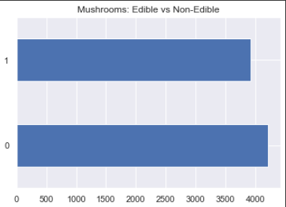
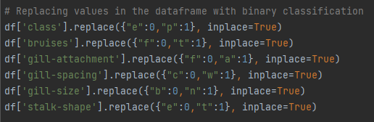
Preparing the data
Notes:
In order to prepare the data for classification, I first had to take each of the attributes and re-code them into integers. After reviewing the data head types (which were all objects) and looking for any nulls (there were none), I reviewed the number of unique values per column. For attributes with only two factors, I recoded them into binary classifications (1 and 0). These attributes included class, bruises, gill attachment, gill spacing, gill size and stalk shape.
Next, I wanted to make sure that my data set has a good balance of both edible and non-edible for mushroom classification, which I was happy and surprised to see the data was well balanced:
Now let’s get the the exciting part, the modeling!

Slide 5
Modeling
Naïve Bayes Classifier
Decision Tree
Logistic Regression
31 Deadly mushrooms identified as edible
0 No Deadly mushrooms identified as edible
0 No Deadly mushrooms identified as edible
 | Predicted Edible | Predicted Poisonous
Actual Edible | 4177 | 524
Actual Poisonous | 31 | 3392
 | Predicted Edible | Predicted Poisonous
Actual Edible | 3916 | 0
Actual Poisonous | 0 | 4208
 | Predicted Edible | Predicted Poisonous
Actual Edible | 3916 | 0
Actual Poisonous | 0 | 4208
Notes:
I ran this data in three separate models: Naïve Bayes Classifier, a Decision Tree and Logistic Regression .
With the Naïve Bayes Classifier, our accuracy was 93%, which seems high, but when we look at the Confusion Matrix, we show that we predicted that 31 poisonous mushrooms were edible. So, although the accuracy is high, it is still unacceptable.
Next, we tried both a decision tree and logistic regression, which gave us 100% accuracy! It also shows us that odor is the #1 identifier for if a mushroom is poisonous, which we also learned during the correlation analysis.

Slide 6
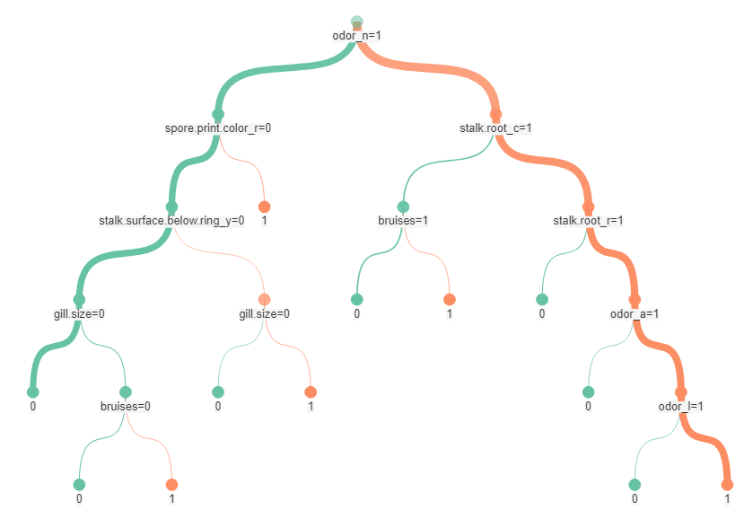
Deep Dive - Decision Tree
Notes:
Although decision trees tend to overfit data, that might not be such a bad thing in this case, as it gives us clear logic on what to look for in a deadly verses edible mushroom. Do not eat the mushroom if it follows the orange path!
If the mushroom has no odor, but the stalk root is club and the mushroom has bruses, DO NOT EAT IT
Also, if the mushroom has a stalk root is rooted and the order has smells like almond=a, anise=l, DO NOT EAT IT
However, if the mushroom does have an odor, and the spore’s print color is green, DO NOT EAT IT
if the mushroom does have an odor, and the spore’s print color is green, DO NOT EAT IT

Slide 7
Conclusion
There are 6 main factors that you need to identify in a mushroom to tell if it’s poisonous:
Odor
Bruises
Gill size
Stalk surface below ring
Spore primary color
Stalk root
If in doubt, throw it out!

Slide 8

GitHub
https://github.com/Emeraldenc/Mushroom-Classification
Notes:
The data along with the code associated with this project is available on my github repository @ github.com/emeraldenc .

